Slide 1
Audit Reports For User Agen Login

Slide 2
Understanding the distribution of user activities during weekdays versus weekends helps in resource allocation, ensuring appropriate staffing and resource availability during peak periods. It helps in understanding user behavior patterns, preferences, and requirements during different times, allowing for tailored service or product offerings.
This Data reflects user behavior when accessing the web. It contains information about controllers, actions, durations, start times, end times, and user agents.
We collected the dataset from the Kaggle platform.
https://www.kaggle.com/datasets/gongetes/auditlog/

Slide 3
659
123,475 minutes
01
04
Total Number of Unique User Agent
Peak duration in minutes in the year of 2023 ,26th march
15
120,842 minutes
02
05
Total Number of Action
Peak duration in Minutes in the year of 2022, 29th November
6
Pengiriman
03
06
Total Number of Controllers
This Controller used Highest 303,750 Minutes

Slide 4
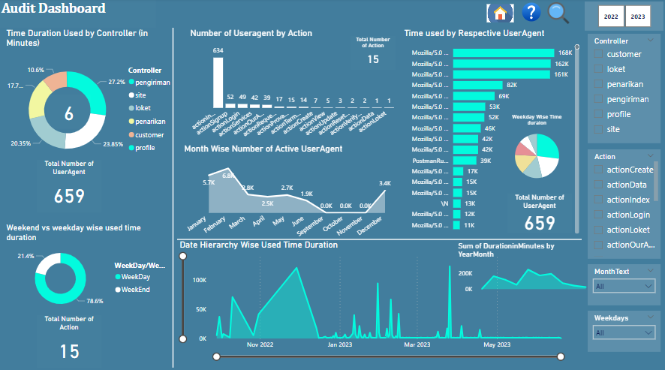

Slide 5
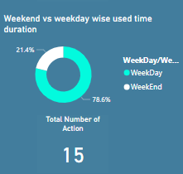
Weekend
Weekday
Weekend Consumes less minutes of 238930
Weekday consumes more minutes of 877711
21.4%
78.6%

Slide 6
Time duration used by Controller
01
02
03
04
05
06
Pengiriman
Site
Loket
Penarikan
Customer
Profile
Pengiriman used 303,750 minutes(27.2%)
Site used 266,312 minutes(23.85%)
Loket used 227,225 minutes(23.35%)
Penarikan used 197,884 minutes(17.72%)
Customer used 118,400 minutes(10.6%)
Profile used 3,070 minutes.

Slide 7
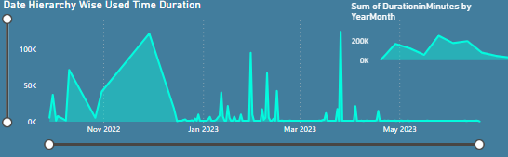
When observing the data, it's clear that on weekdays, 555 user agents logged in under 6 controllers, whereas during the weekend, 318 user agents logged in under 4 controllers, excluding Pengiriman and Customer. Additionally, 9 actions were performed during the weekend compared to all 15 actions performed on weekdays by the 6 controllers.
In the year 2023, January 30th recorded 94,440 minutes, and March 26th observed 123,475 minutes as the peak durations. To allow for a more detailed view, I've implemented a zoom slider enabling the examination of each segment within the date hierarchy.

Slide 8
Thank You

